Slide 1
Python Lecture 6

Slide 2
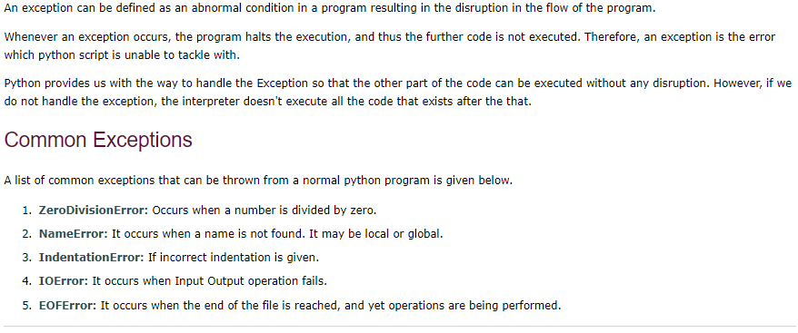
Exception handling provides a mechanism to halt the program in a c controlled manner with a user friendly message,

Slide 3
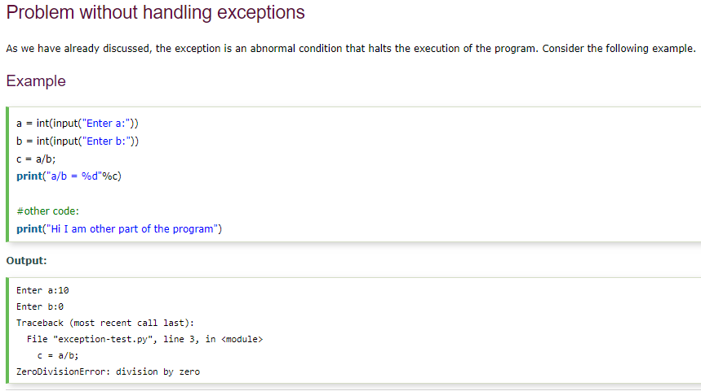

Slide 4
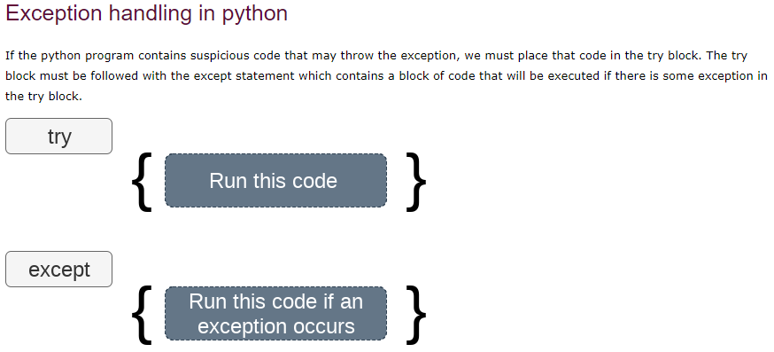

Slide 5
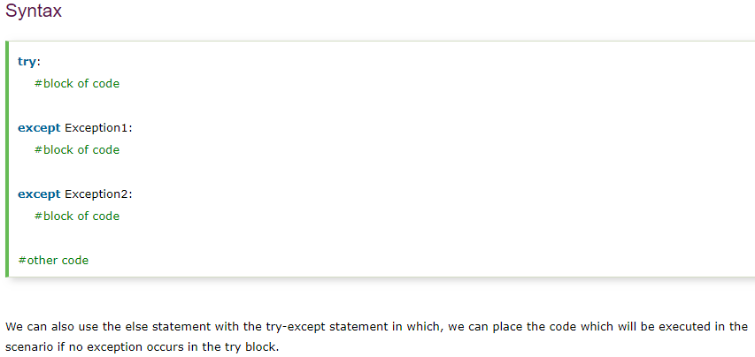

Slide 6
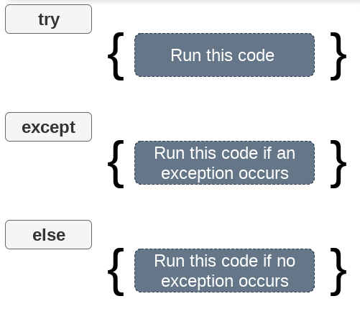

Slide 7
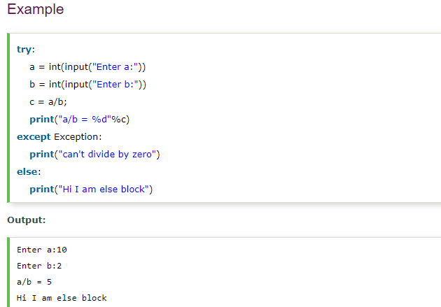

Slide 8
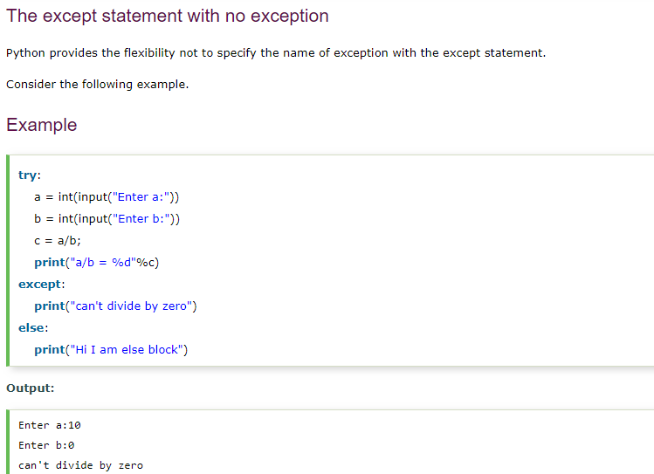

Slide 9
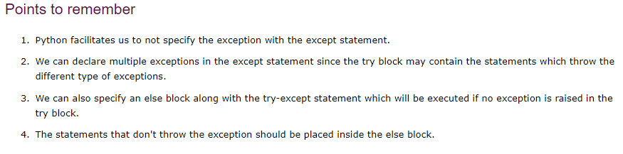

Slide 10
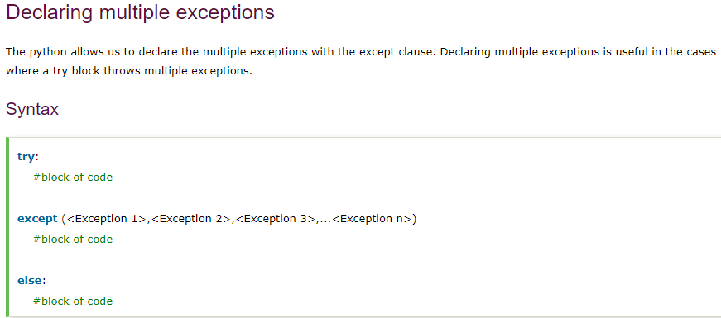

Slide 11
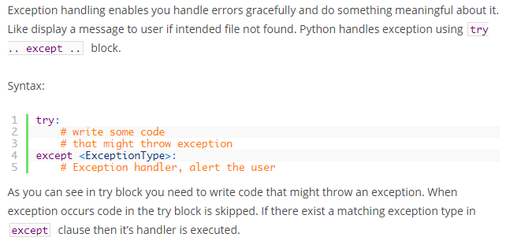

Slide 12
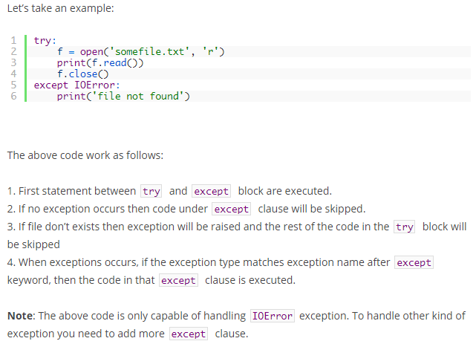
Except Exception as e:
print(e)

Slide 13
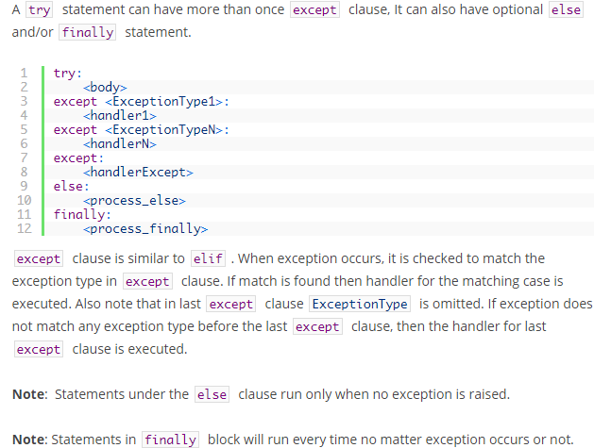

Slide 14
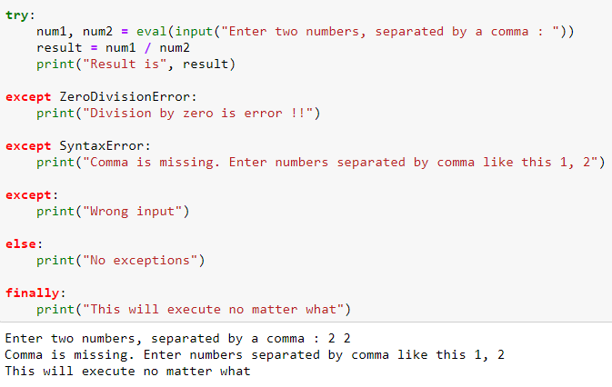
eval() evaluates the passed string as a Python expression and returns the result.
The expression argument is parsed and evaluated as a Python expression
For example, eval("1 + 1") interprets and executes the expression "1 + 1" and returns the result (2).

Slide 15
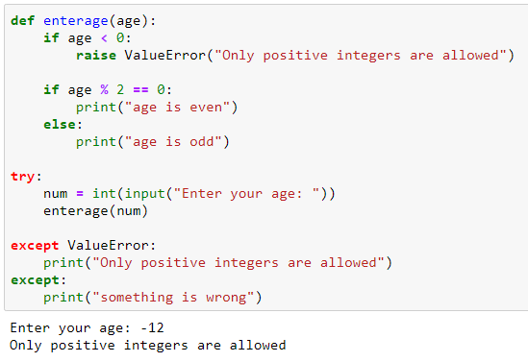
Exept ValueError as e:
Print(e)

Slide 16
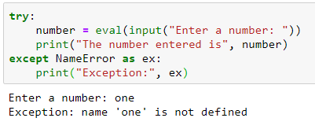
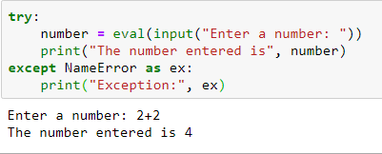
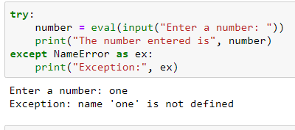
Notes:
# eval (a+a) evaluates it as expression by considering the aschii code of a

Slide 17
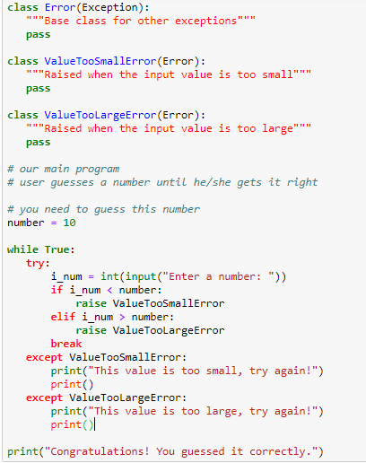

Slide 18
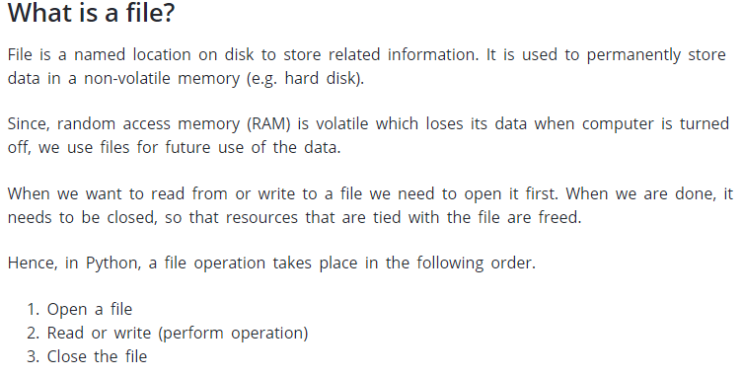

Slide 19
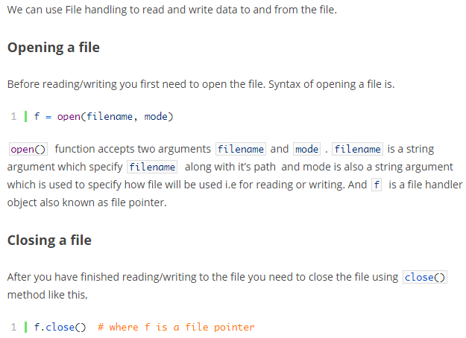
Python File Handling

Slide 20
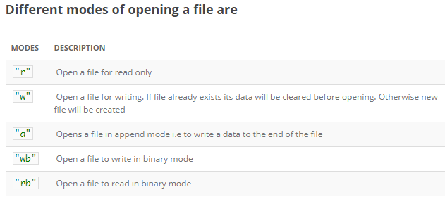

Slide 21
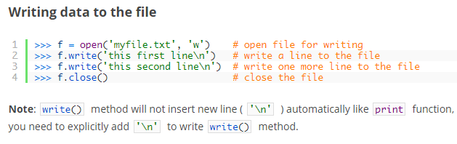
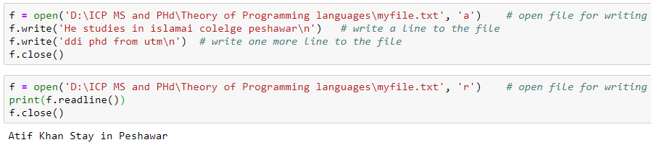

Slide 22
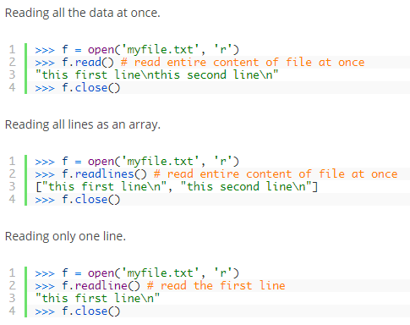
Print(f.readlines())

Slide 23
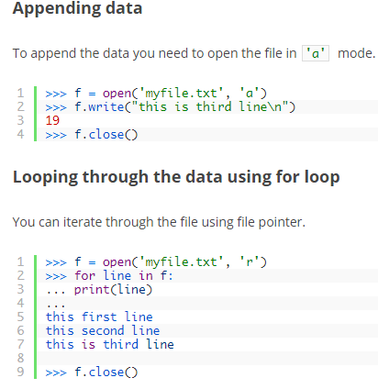

Slide 24
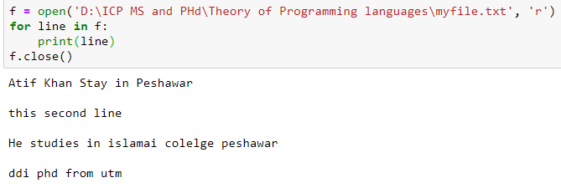

Slide 25
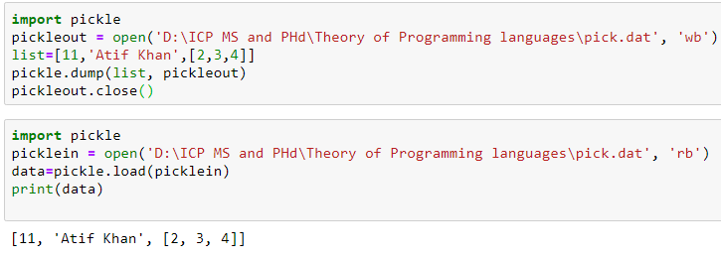

Slide 26
Pickle Module — Python object serialization (Marshalling) Pickling in Python
The pickle module is used for for serializing and de-serializing a Python object structure.
Pickling: It is a process where a Python object hierarchy is converted into a byte stream.
Unpickling: It is the inverse of Pickling process where a byte stream is converted into an object hierarchy.
Module Interface :
dumps() – This function is called to serialize an object hierarchy.
loads() – This function is called to de-serialize a data stream.

Slide 27
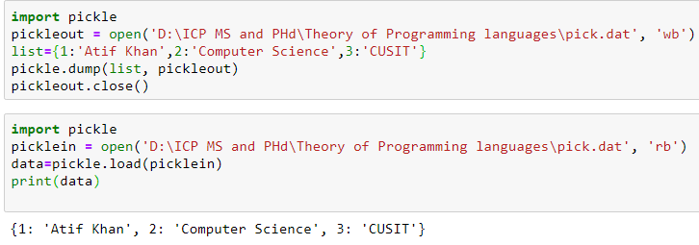

Slide 28
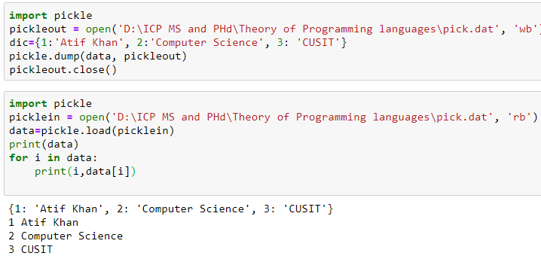

Slide 29
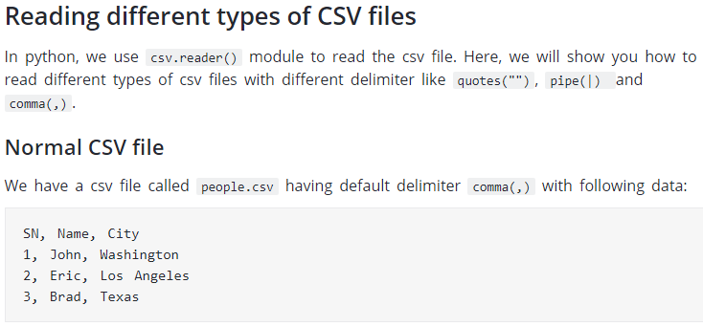

Slide 30
